Slide 1
GDL Lecture 5: GRAPHS & SETS I
Levan Bokeria
GNN Reading group presentation, 2023-11-08
Slides adapted from the lecture slides of Petar Veličković

Slide 2
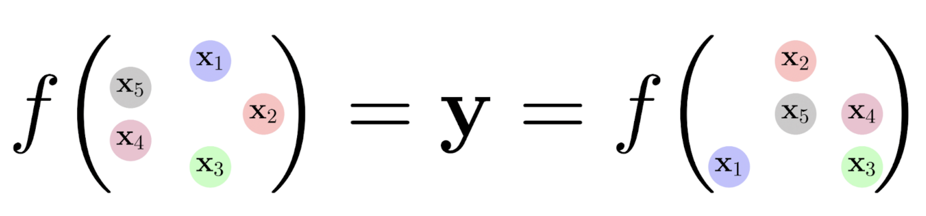
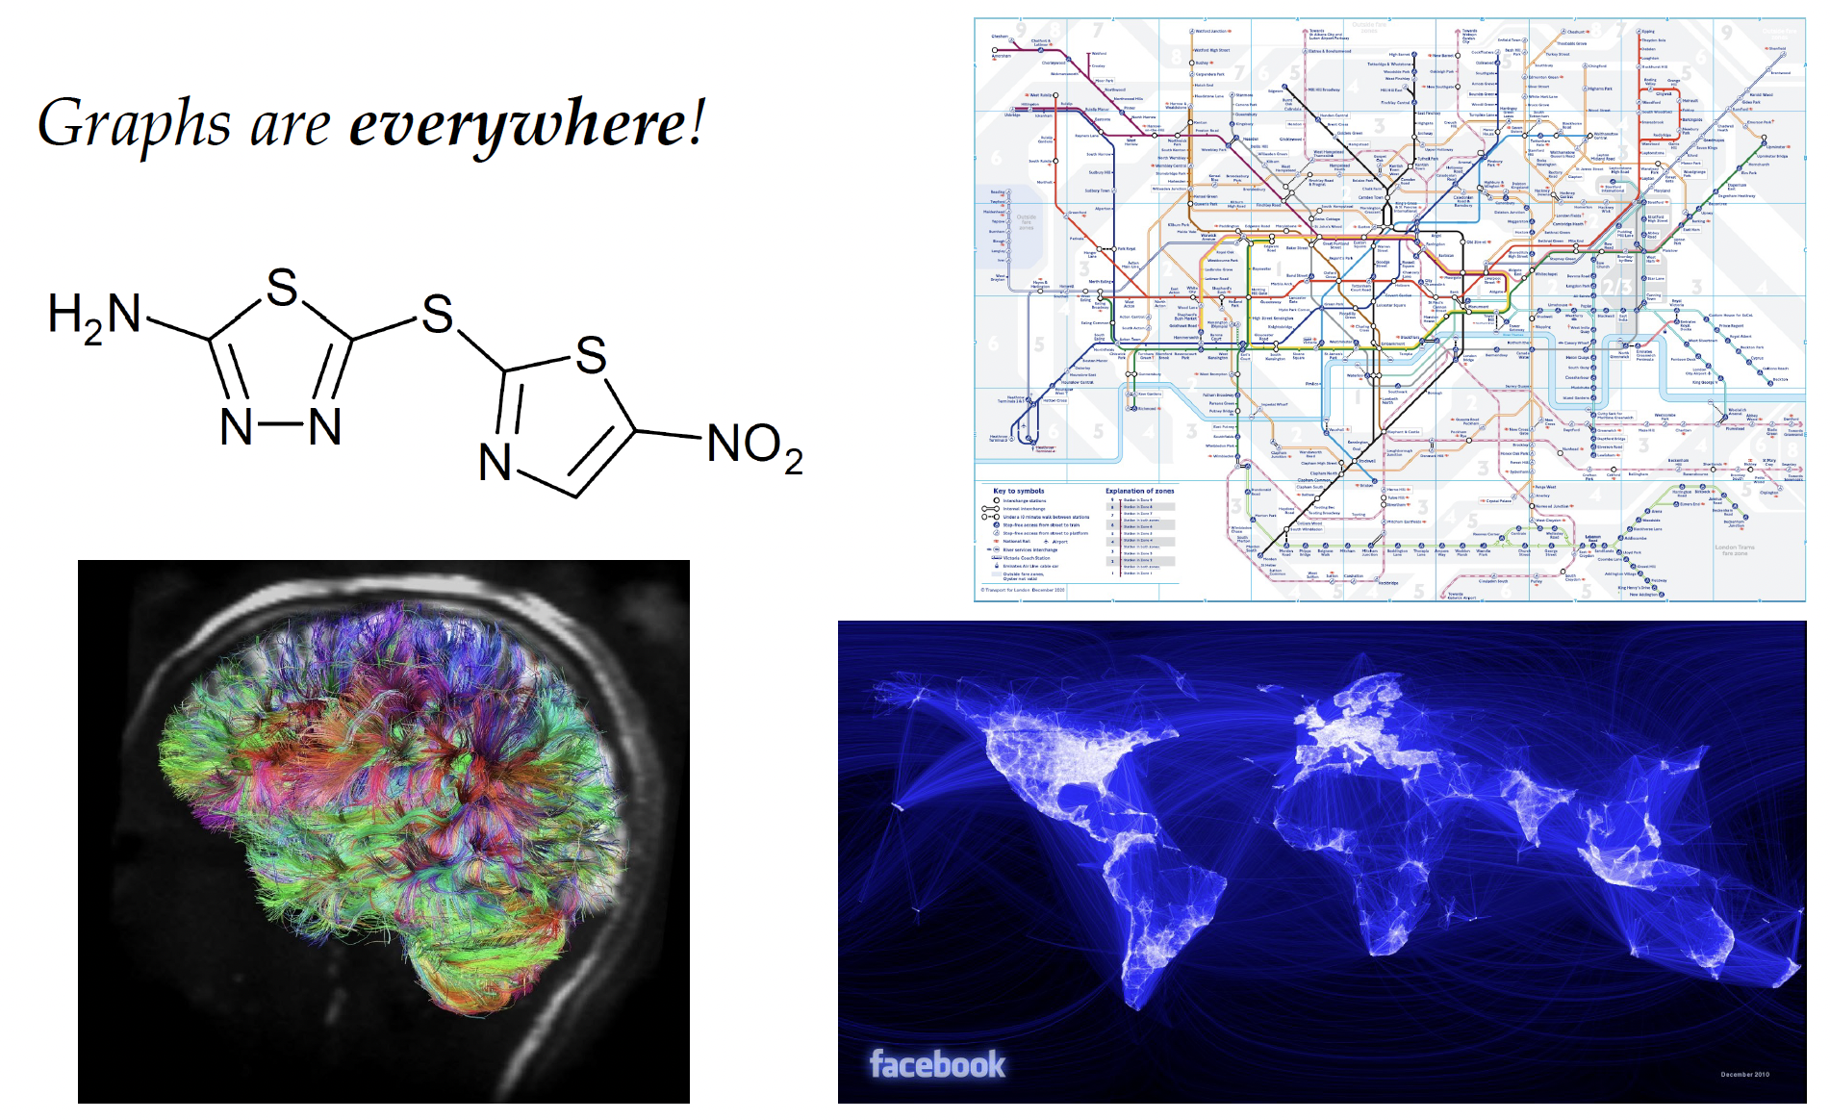
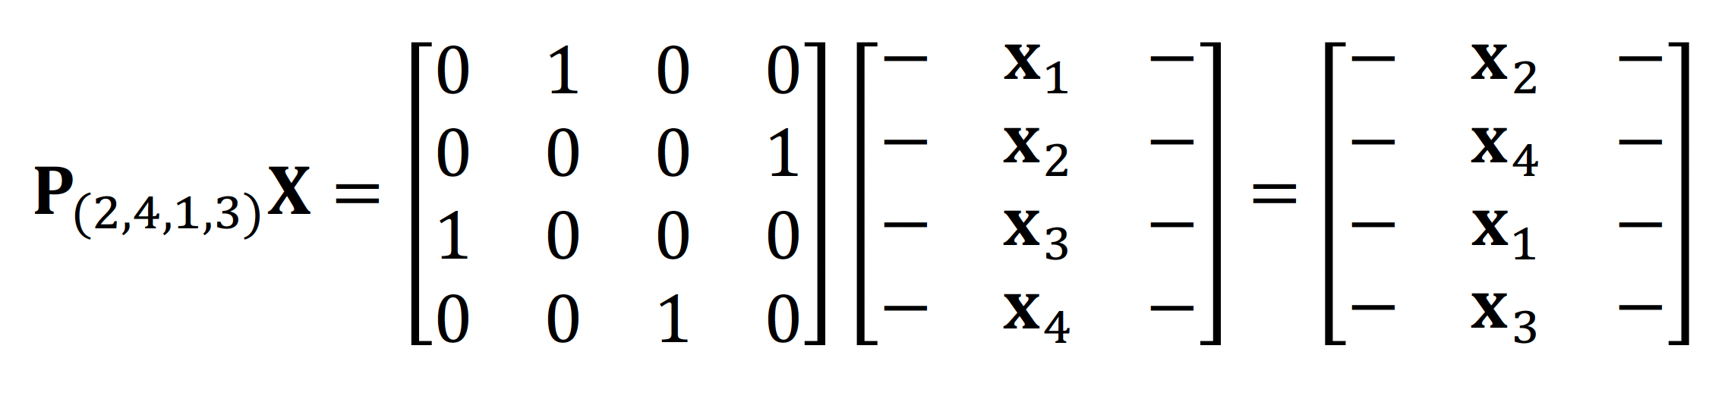
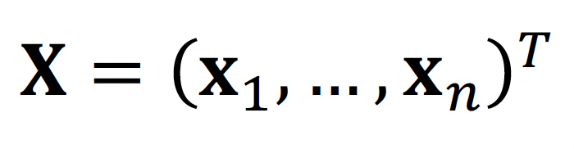
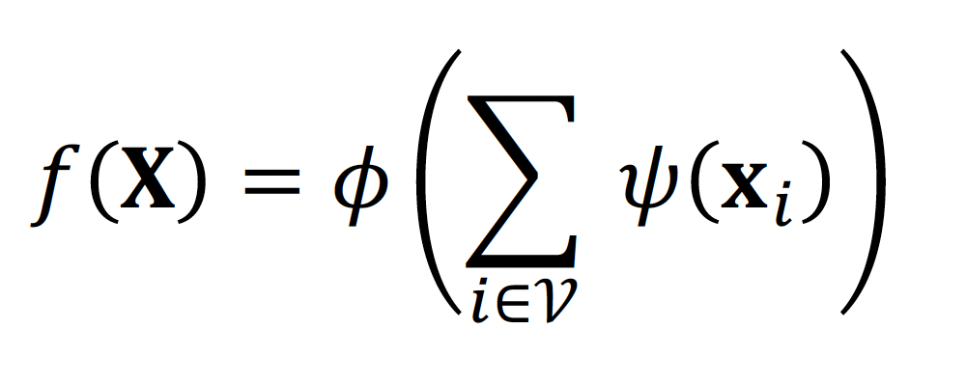
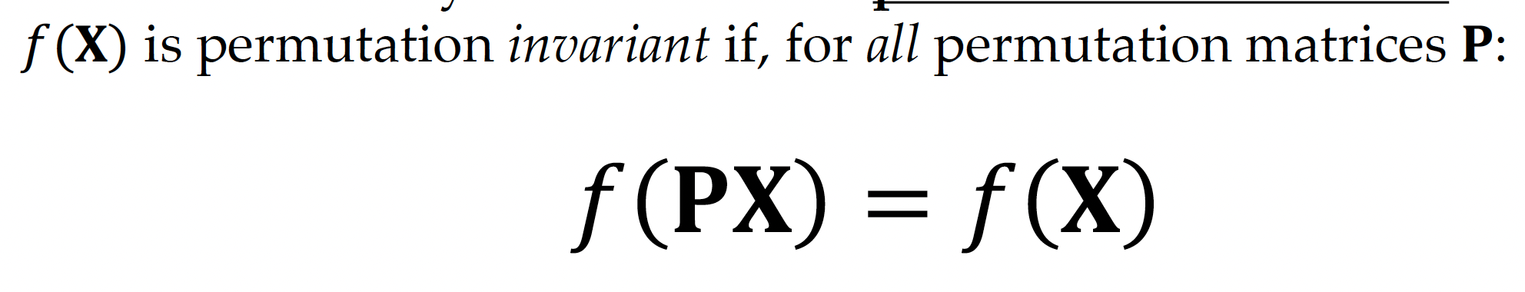
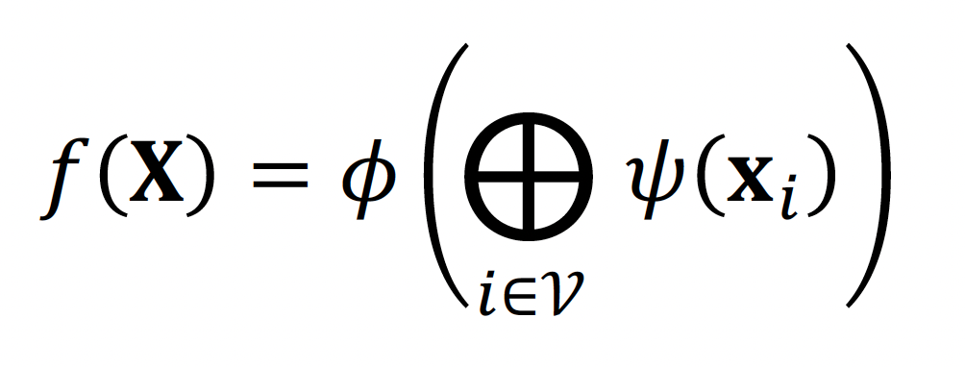
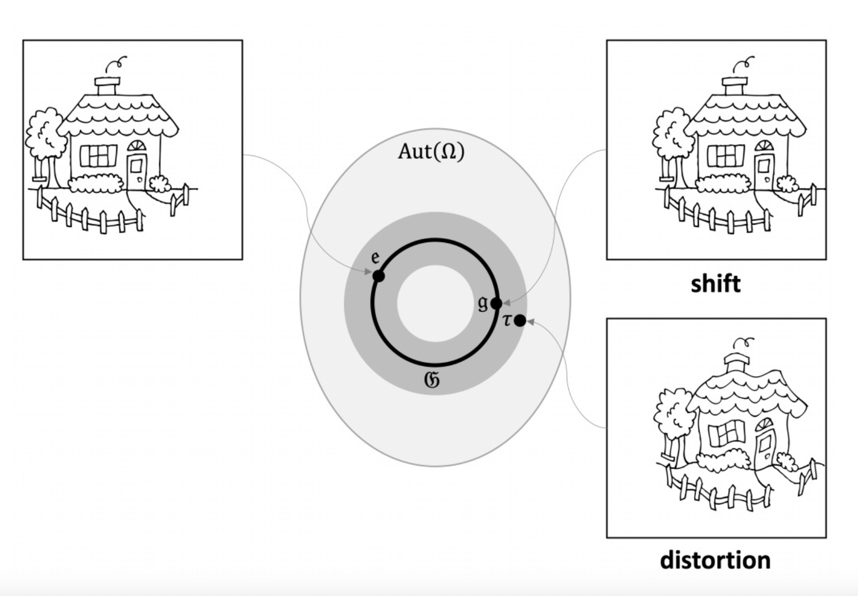
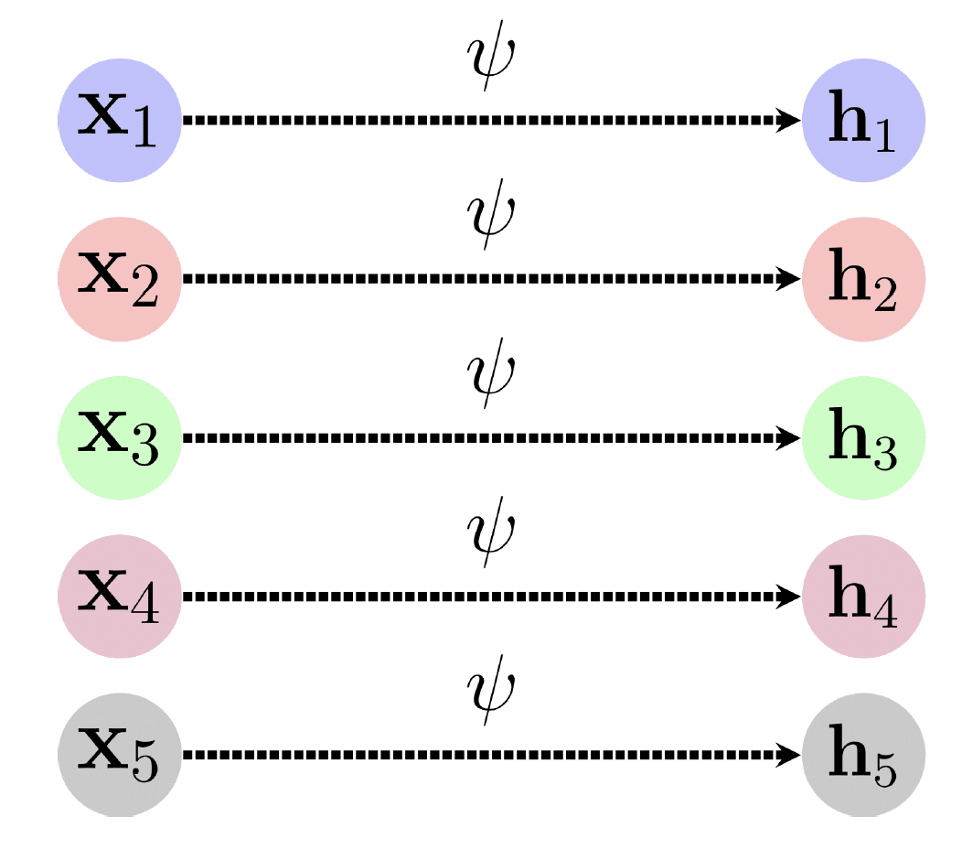
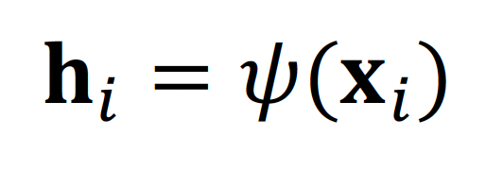
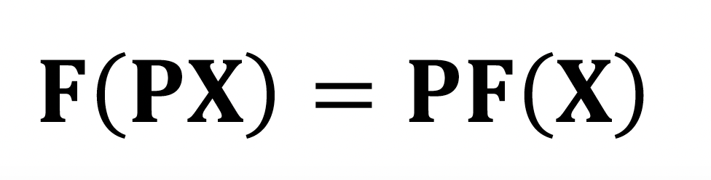
Part 1 overview:
Permutation invariance:
Permutation equivariance:

Slide 3
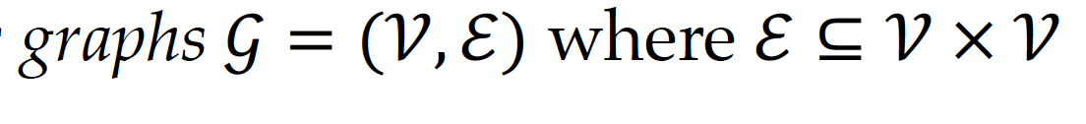
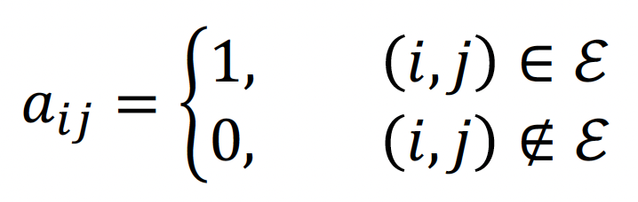
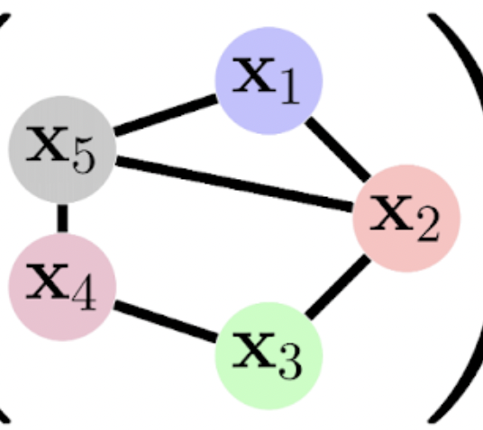
Part 2: graphs with edges
Adjacency matrix A
 | x₁ | x₂ | x₃ | x₄ | x₅
x₁ | - | 1 | 0 | 0 | 1
x₂ | 1 | - | 1 | 0 | 1
x₃ | 0 | 1 | - | 1 | 0
x₄ | 0 | 0 | 1 | - | 1
x₅ | 1 | 1 | 0 | 1 | -
Notes:
Simplifying so that edges are just 1 and 0. Could also be other ways of representing them.

Slide 4
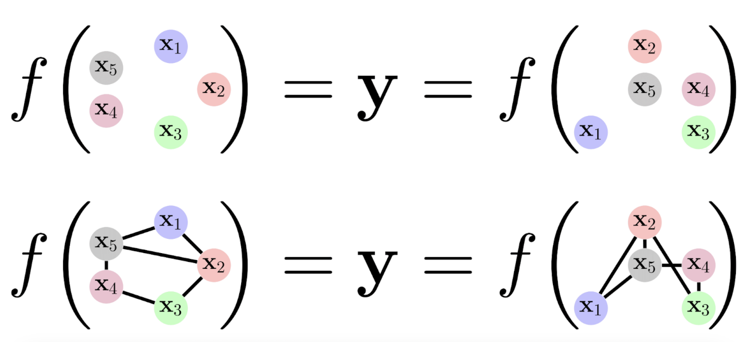
Part 2: graphs with edges
Adjacency matrix A
 | x₁ | x₂ | x₃ | x₄ | x₅
x₁ | - | 1 | 0 | 0 | 1
x₂ | 1 | - | 1 | 0 | 1
x₃ | 0 | 1 | - | 1 | 0
x₄ | 0 | 0 | 1 | - | 1
x₅ | 1 | 1 | 0 | 1 | -
Notes:
Simplifying so that edges are just 1 and 0. Could also be other ways of representing them.

Slide 5
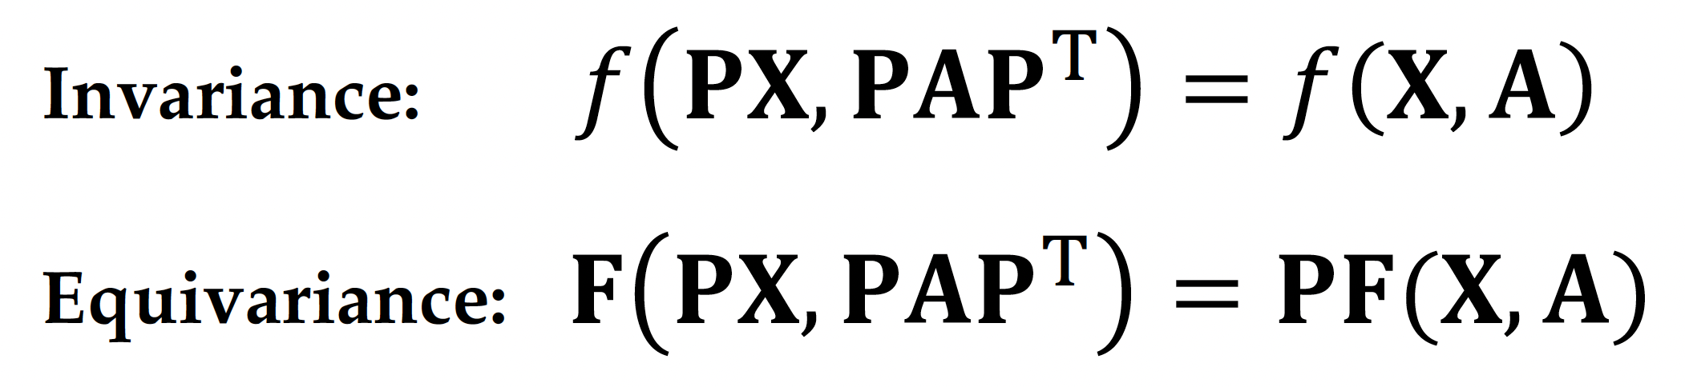
Part 2: graphs with edges
Adjacency matrix A
 | x₁ | x₂ | x₃ | x₄ | x₅
x₁ | - | 1 | 0 | 0 | 1
x₂ | 1 | - | 1 | 0 | 1
x₃ | 0 | 1 | - | 1 | 0
x₄ | 0 | 0 | 1 | - | 1
x₅ | 1 | 1 | 0 | 1 | -
Notes:
Simplifying so that edges are just 1 and 0. Could also be other ways of representing them.

Slide 6
Part 2: graphs with edges
Adjacency matrix A
 | x₁ | x₂ | x₃ | x₄ | x₅
x₁ | - | 1 | 0 | 0 | 1
x₂ | 1 | - | 1 | 0 | 1
x₃ | 0 | 1 | - | 1 | 0
x₄ | 0 | 0 | 1 | - | 1
x₅ | 1 | 1 | 0 | 1 | -
Notes:
Simplifying so that edges are just 1 and 0. Could also be other ways of representing them.

Slide 7
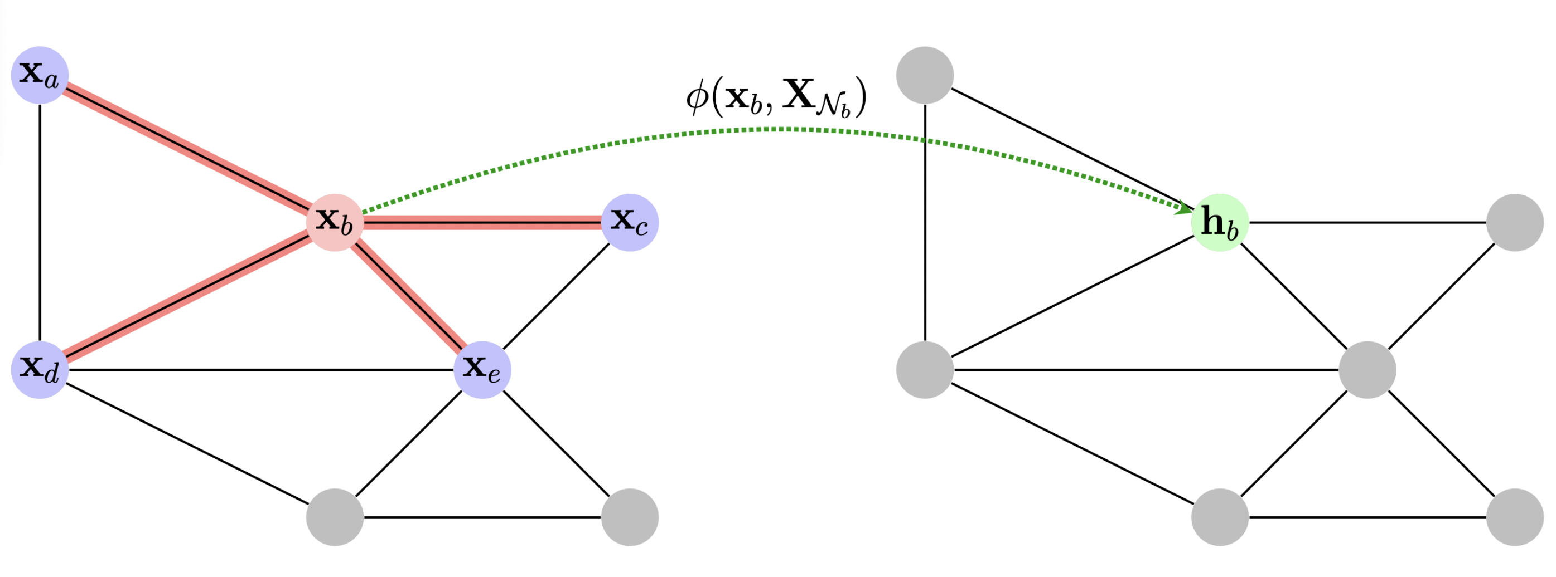
Locality on graphs: Neighborhoods

Slide 8
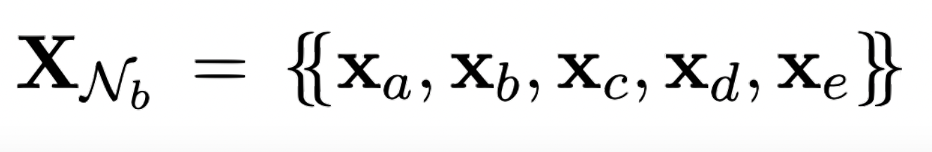
Locality on graphs: Neighborhoods

Slide 9
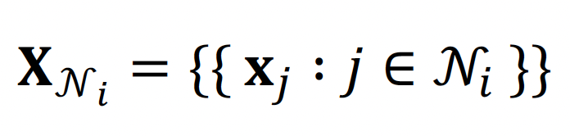
Locality on graphs: Neighborhoods

Slide 10
Locality on graphs: Neighborhoods

Slide 11
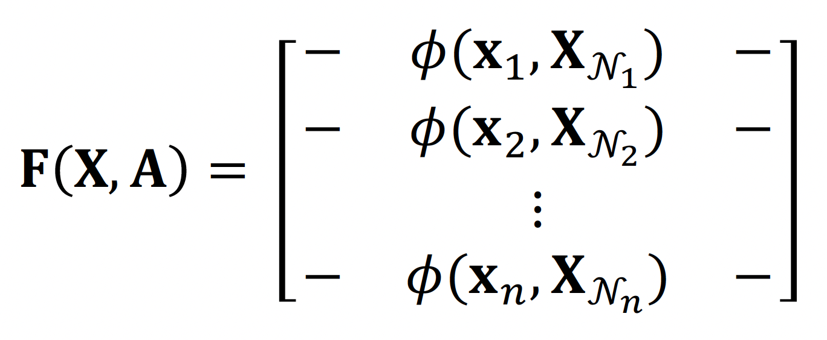
Locality on graphs: Neighborhoods
Notes:
Important the phi is invariant.

Slide 12
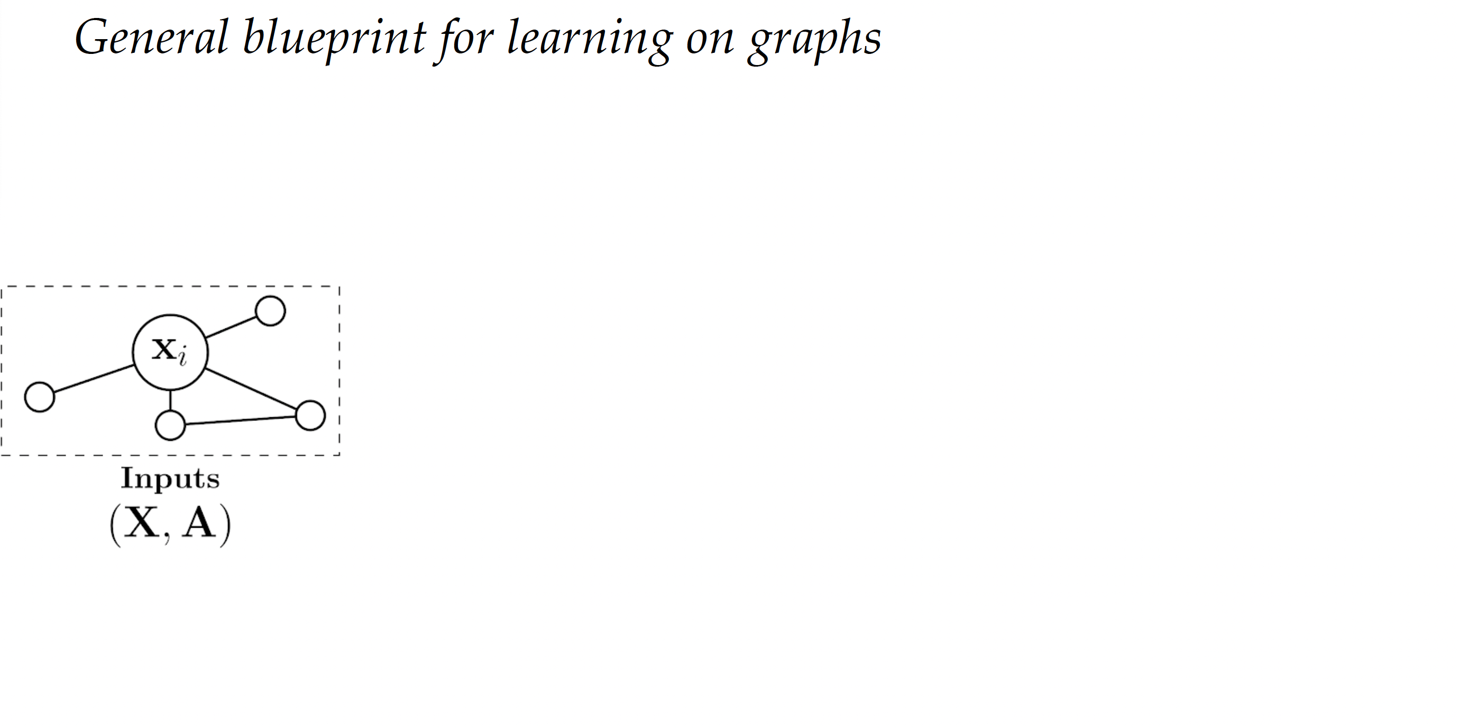

Slide 13
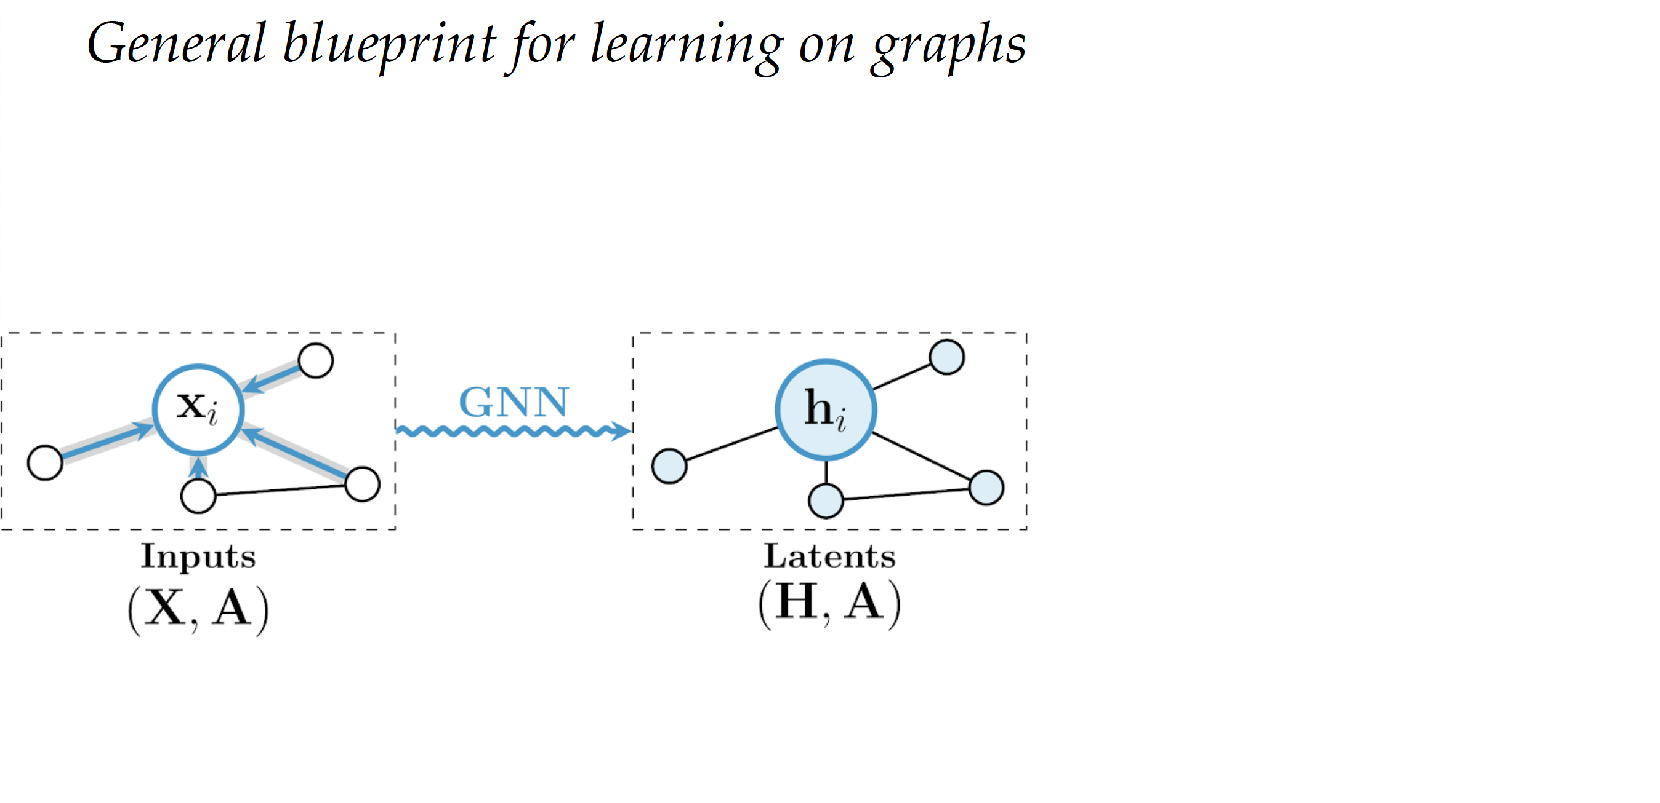

Slide 14
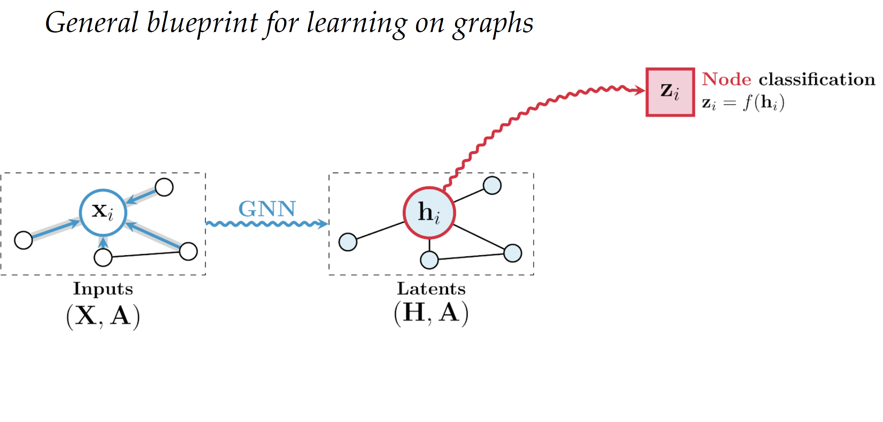

Slide 15
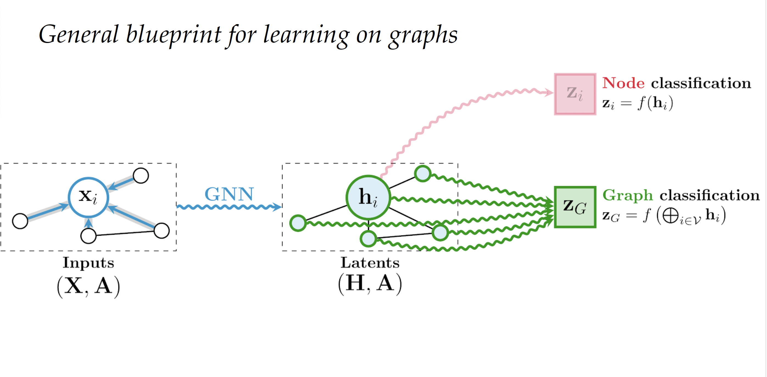

Slide 16
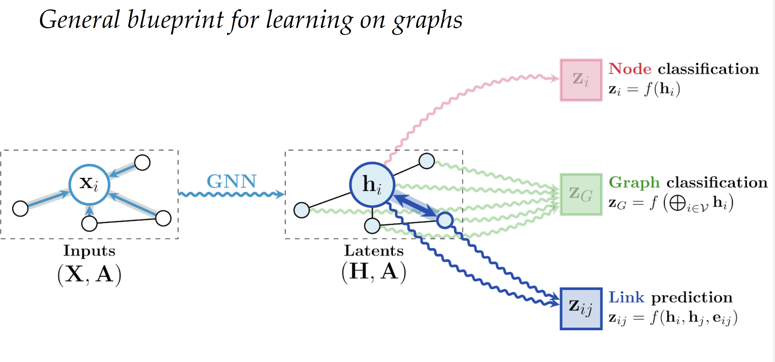

Slide 17
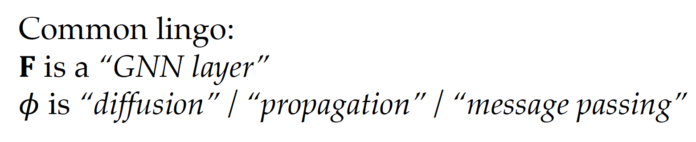

Slide 18
Cambridge
Cambridge
London
London
Oxford
Oxford

Slide 19
Is London a tourist hub?
Cambridge
Cambridge
London
London
Oxford
Oxford
Is this a developed or a developing
country?
Is there a direct train?

Slide 20
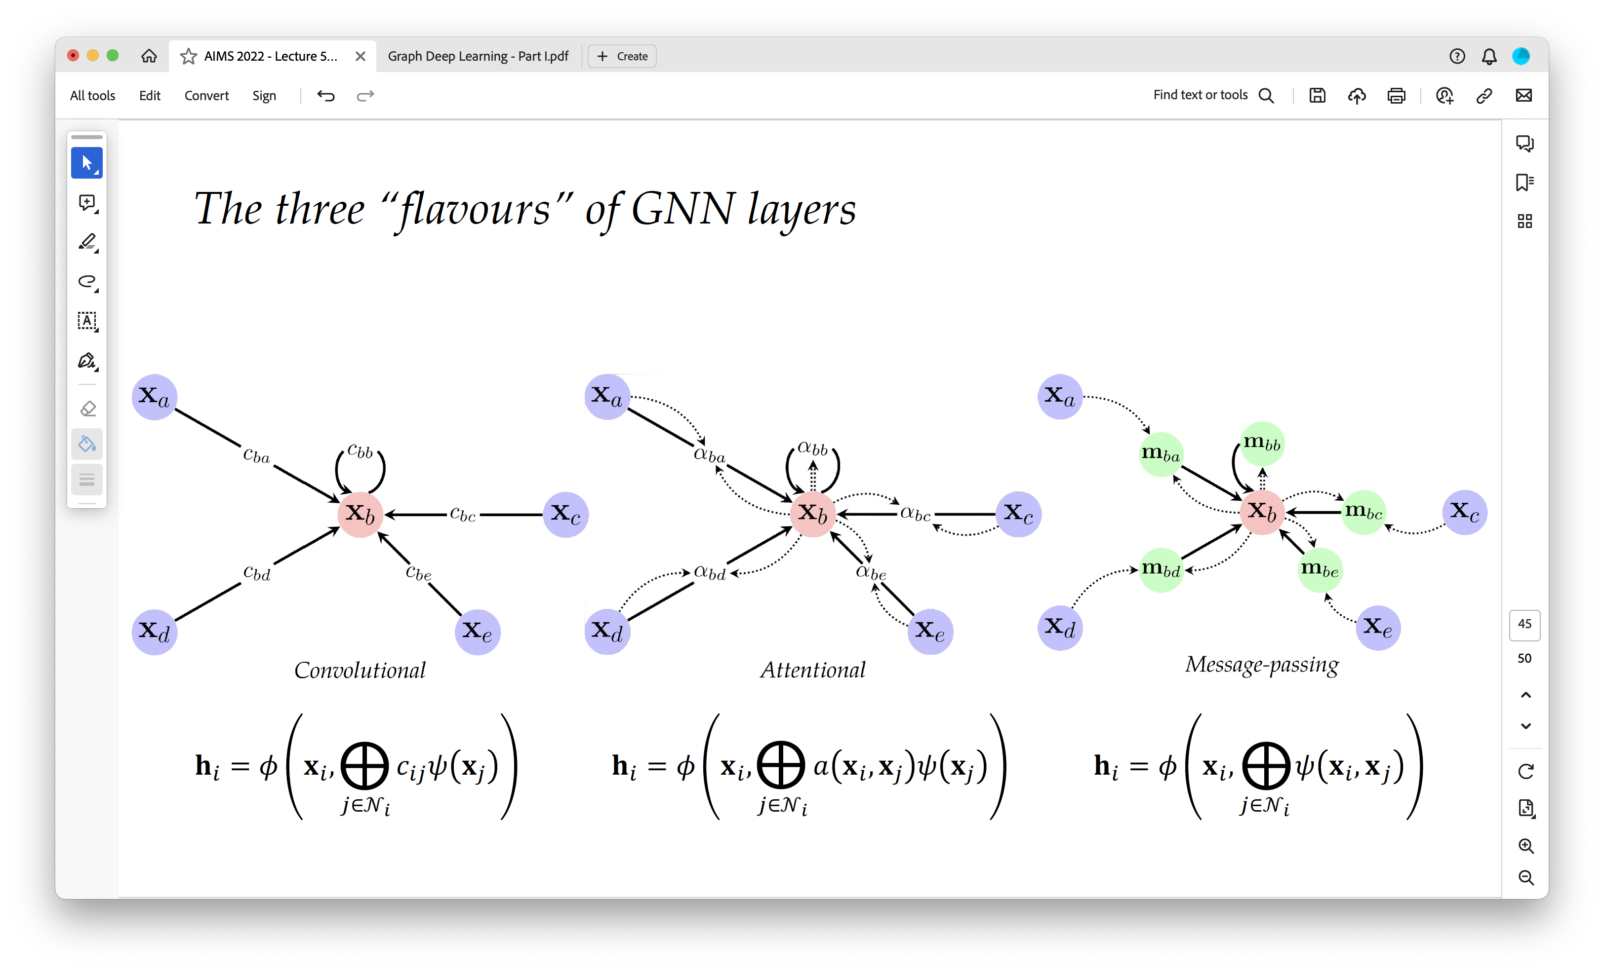
Notes:
Increasing generality, decreasing scaleability.

Slide 22
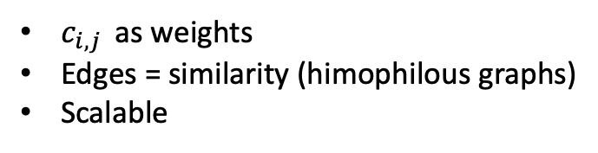
$c_{i,j }$ as weights
Edges = similarity (himophilous graphs)
Scalable

Slide 23
$c_{i,j }$ as weights
Edges = similarity (himophilous graphs)
Scalable

Slide 24
$c_{i,j }$ as weights
Edges = similarity (himophilous graphs)
Scalable

Slide 25
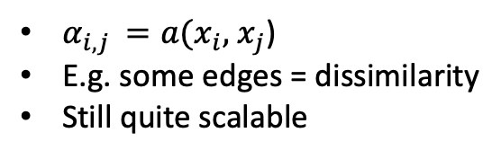
$c_{i,j }$ as weights
Edges = similarity (himophilous graphs)
Scalable
$α_{i,j }=a(x_{i},$ $x_{j}$)
E.g. some edges = dissimilarity
Still quite scalable

Slide 26
$c_{i,j }$ as weights
Edges = similarity (himophilous graphs)
Scalable
$α_{i,j }=a(x_{i},$ $x_{j}$)
E.g. some edges = dissimilarity
Still quite scalable

Slide 27
$c_{i,j }$ as weights
Edges = similarity (himophilous graphs)
Scalable
$α_{i,j }=a(x_{i},$ $x_{j}$)
E.g. some edges = dissimilarity
Still quite scalable

Slide 28
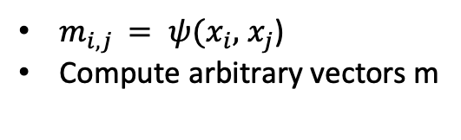
$c_{i,j }$ as weights
Edges = similarity (himophilous graphs)
Scalable
$α_{i,j }=a(x_{i},$ $x_{j}$)
E.g. some edges = dissimilarity
Still quite scalable
$m_{i,j }= ψ(x_{i},$ $x_{j}$)
Compute arbitrary vectors m

Slide 29
$c_{i,j }$ as weights
Edges = similarity (himophilous graphs)
Scalable
$α_{i,j }=a(x_{i},$ $x_{j}$)
E.g. some edges = dissimilarity
Still quite scalable
$m_{i,j }= ψ(x_{i},$ $x_{j}$)
Compute arbitrary vectors m

